Slide 1
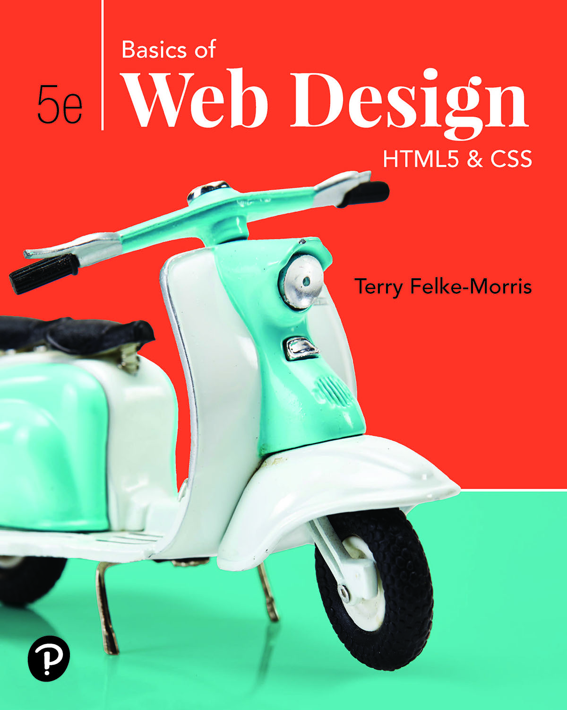
Basics of Web Design
Fifth Edition
Chapter 7
Page Layout Basics Key Concepts
Slide in this Presentation Contain Hyperlinks. JAWS users should be able to get a list of links by using INSERT+F7
Copyright © 2019 Pearson Education, Inc. All Rights Reserved
Notes:
If this PowerPoint presentation contains mathematical equations, you may need to check that your computer has the following installed:
1) Math Type Plugin
2) Math Player (free versions available)
3) NVDA Reader (free versions available)

Slide 2
Learning Outcomes
Configure float
Configure fixed positioning
Configure relative positioning
Configure absolute positioning
Create two-column page layouts
Configure vertical navigation in an unordered list
Configure horizontal navigation in an unordered list.
Add interactivity to hyperlinks with C S S pseudo-classes
Configure C S S sprites
Configure C S S for print
Configure stacking order

Slide 3
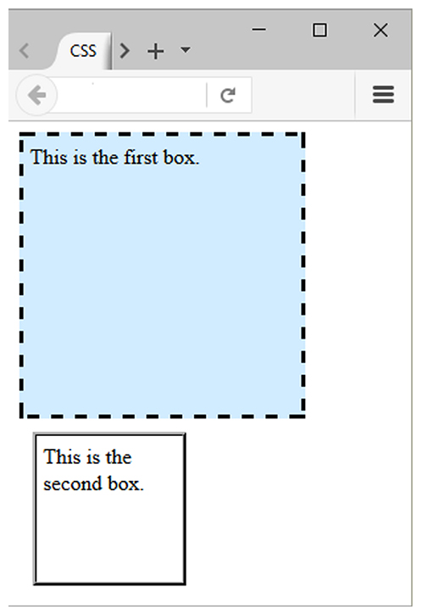
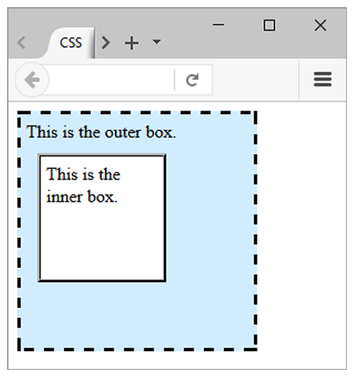
Normal Flow
Browser display of elements in the order they are coded in the Web page document
Figure 7.1
Figure 7.2

Slide 4
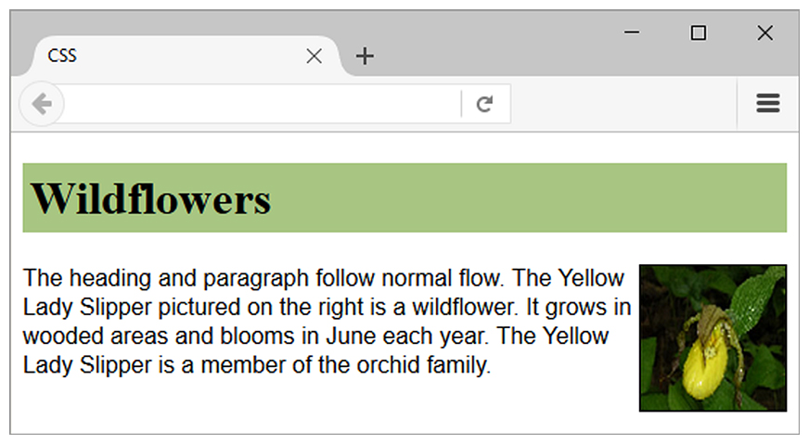
float Property
Elements that seem to “float” on the right or left side of either the browser window or another element are often configured using the C S S float property.
h1 { background-color: #A 8 C 6 8 2;
padding: 5px;
color: #000000; }
p { font-family: Arial, sans-serif; }
#yls { float: right;
margin: 0 0 5px 5px;
border: solid; }

Slide 5
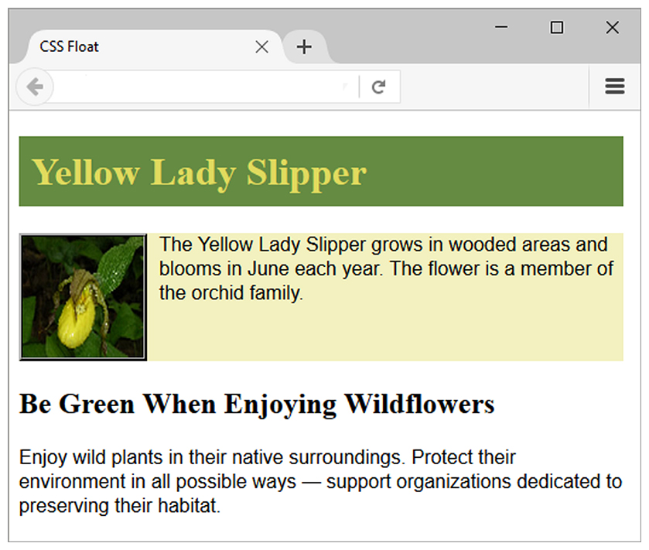
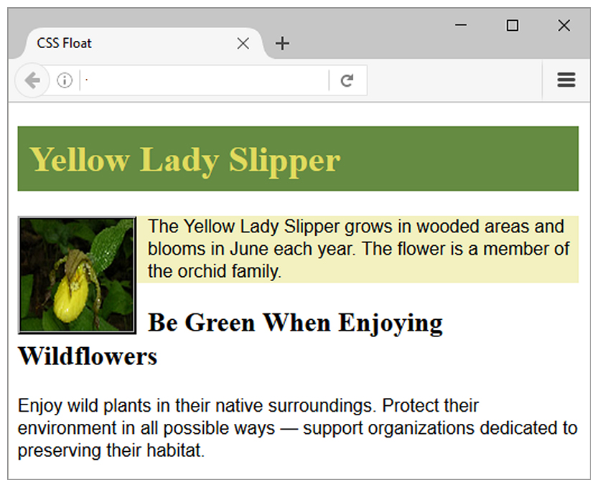
clear Property
Useful to “clear” or terminate a float
Values are left, right, and both
The h2 text is displayed in normal flow.
clear: left; was applied to the h2. Now the h2 text displays AFTER the floated image.

Slide 6
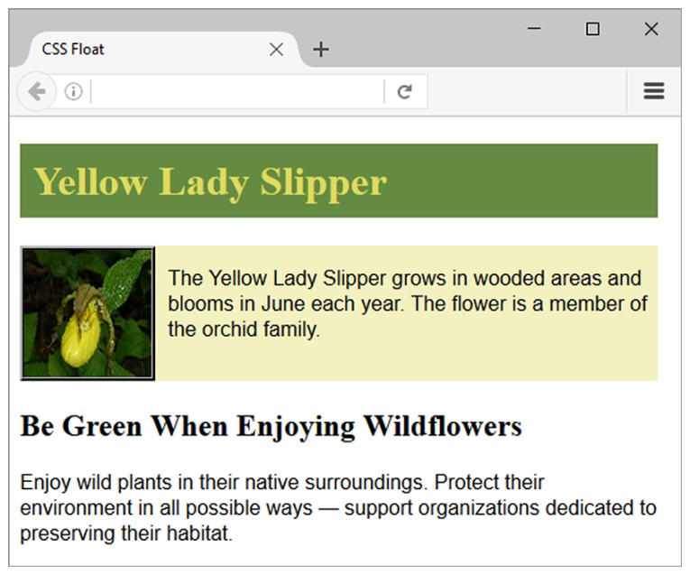

overflow Property
Configures the display of elements on a web page.
Useful to “clear” or terminate a float before the end of a container element
Values are auto, hidden, and scroll
overflow: auto; was applied to the container div. Now the background extends and the h2 text displays AFTER the floated image.
The background does not extend as far as you’d expect.

Slide 7
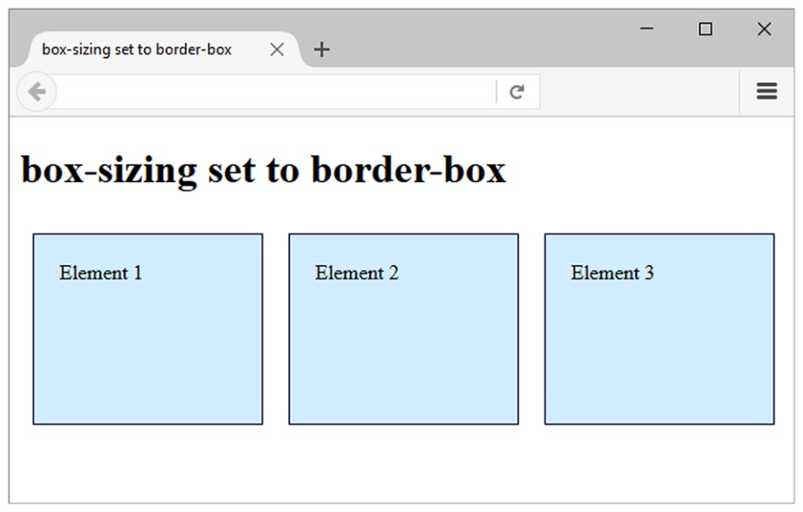
The C S S box-sizing Property
Default value for width or height is the value for ONLY the content (not including border and padding).
The box-sizing property is used to selector to direct the browser to calculate the width and height of an element to include the value for content, padding, and border.
Use the universal selector (*) to apply this to all the element on the page
Example:
* { box-sizing: border-box; }

Slide 8
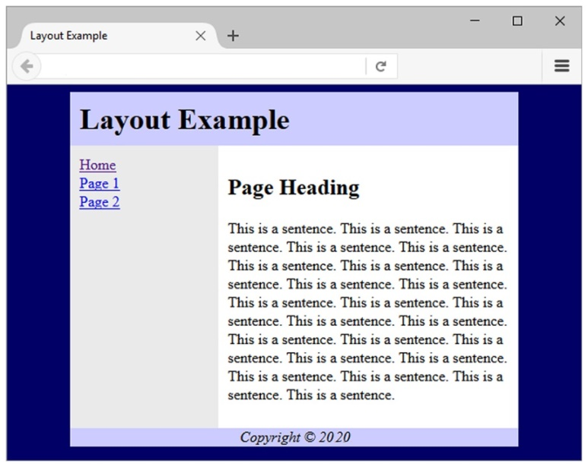
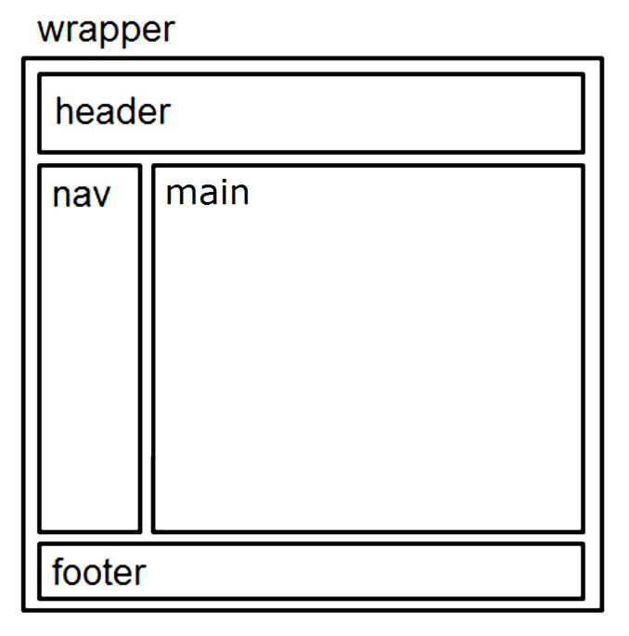
Basic Two-Column Layout (1 of 2)
<body>
<div id="wrapper">
<header> <header>
<nav> </nav>
<main> </main>
<footer> </footer>
</div>
</body>

Slide 9

Basic Two-Column Layout (2 of 2)
#wrapper { width: 80%;
margin-left: auto;
margin-right: auto;
background-color: #E A E A E A; }
header { background-color: #C C C C F F; }
h1 { margin: 0; padding: 10px; }
nav { float: left;
width: 150px;
padding: 10px; }
main { margin-left: 160px;
padding: 10px;
background-color: #F F F F F F; }
footer { text-align: center;
font-style: italic;
background-color: #C C C C F F; }

Slide 10
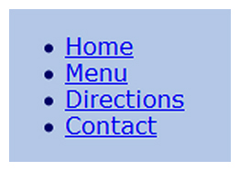
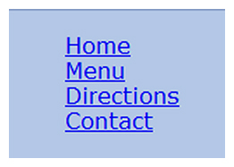
Vertical Navigation with an Unordered List
<nav>
<ul>
<li><a href="index.html">Home</a></li>
<li><a href="menu.html">Menu</a></li>
<li><a href="directions.html">Directions</a></li>
<li><a href="contact.html">Contact</a></li>
</ul>
</nav>
C S S removes the list marker and underline:
nav ul { list-style-type: none; }
nav a { text-decoration: none; }

Slide 11
Display Property
Configures how and if an element is displayed
display: none;
The element will not be displayed.
display: block;
The element is rendered as a block element even if it is actually an inline element, such as a hyperlink.
display: inline;
The element will be rendered as an inline element even if it is actually a block element, such as a <li>.

Slide 12

Horizontal Navigation with an Unordered List
<nav>
<ul>
<li><a href="index.html">Home</a></li>
<li><a href="menu.html">Menu</a></li>
<li><a href="directions.html">Directions</a></li>
<li><a href="contact.html">Contact</a></li>
</ul>
</nav>
C S S removes the list marker, removes the underline, adds padding, and configures the list items for inline display.
nav ul { list-style-type: none;}
nav a { text-decoration: none;
padding-right: 10px; }
nav li { display: inline; }

Slide 13
C S S Pseudo-classes (1 of 2)
Pseudo-classes and the anchor element
:link – default state for a hyperlink
:visited –a hyperlink that has been visited
:focus – triggered when the hyperlink has focus
:hover – triggered when the mouse moves over the hyperlink
:active – triggered when the hyperlink is being clicked
a:link {color:#000066;}
a:visited {color:#003366;}
a:focus {color:#F F0000;}
a:hover {color:#0099C C;}
a:active {color:#F F0000;}

Slide 14
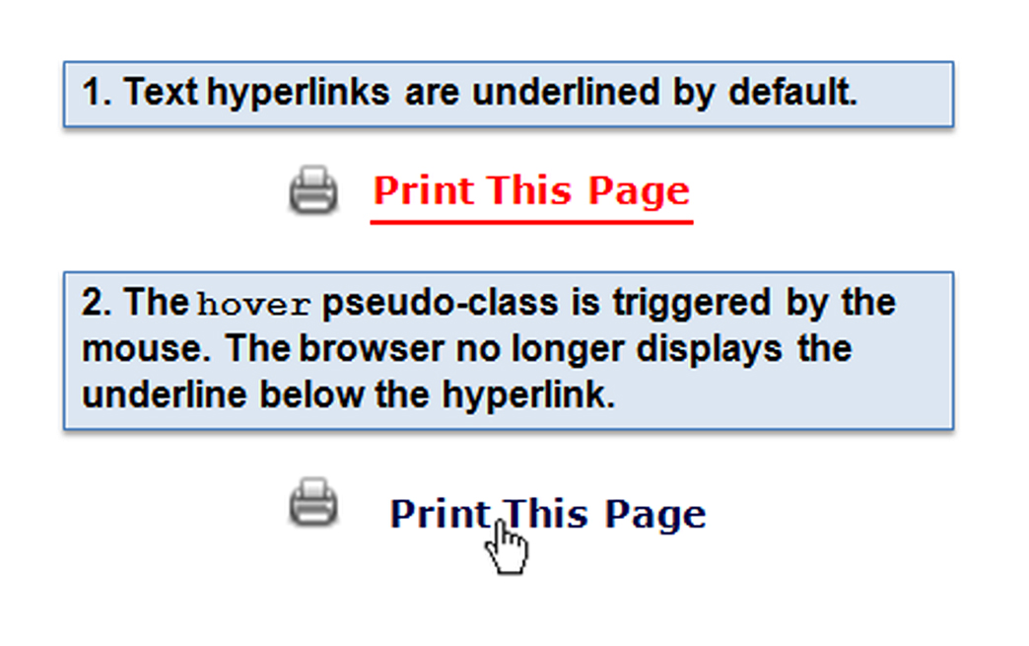
C S S Pseudo-classes (2 of 2)
a:link { color: #ff0000; }
a:hover { text-decoration: none;
color: #000066; }

Slide 15
C S S Styling for Print
Create an external style sheet with the configurations for browser display.
Create a second external style sheet with the configurations for printing.
Connect both of the external style sheets to the web page using two <link > elements.
<link rel="stylesheet" href="lighthouse.css" media="screen">
<link rel="stylesheet" href="lighthouseprint.css" media="print">

Slide 16
Print Styling Best Practices
Hide non-essential content
Example:
nav { display: none; }
Configure font size and color for printing
Use pt font sizes, use dark text color
Control page breaks
Example: .newpage { page-break-before: always; }

Slide 17
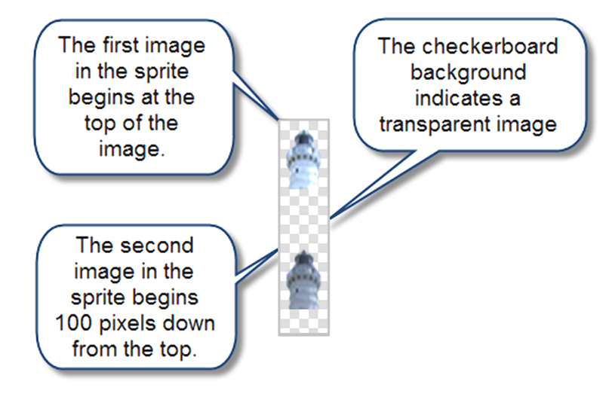
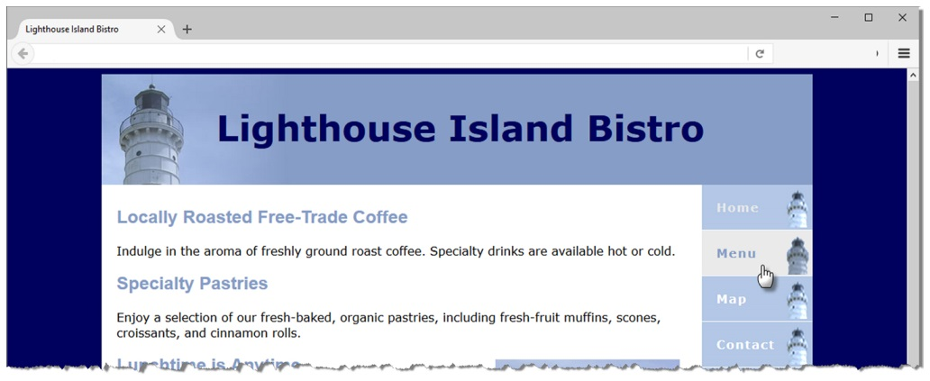
C S S Sprites
Sprite
an image file that contains multiple small graphics
advantage: saves download time

Slide 18
Position Property
Table 7.5 The position Property
Value | Purpose
static | Default value; the element is rendered in normal flow
fixed | Configures the location of an element within the browser viewport; the element does not move when the page is scrolled
relative | Configures the location of an element relative to where it would otherwise render in normal flow
absolute | Precisely configures the location of an element outside of normal flow

Slide 19
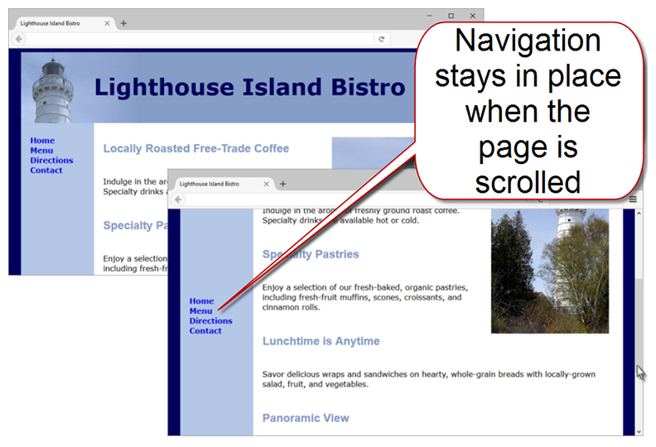
Fixed Positioning
nav { position: fixed; }

Slide 20
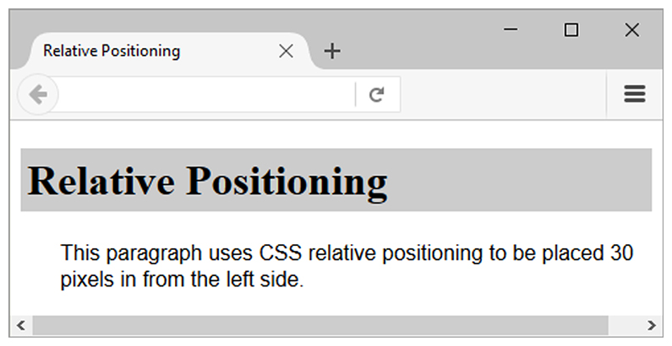
Relative Positioning
p { position: relative;
left: 30px;
font-family: Arial, sans-serif; }
Changes the location of an element in relation to where it would otherwise appear in normal flow

Slide 21
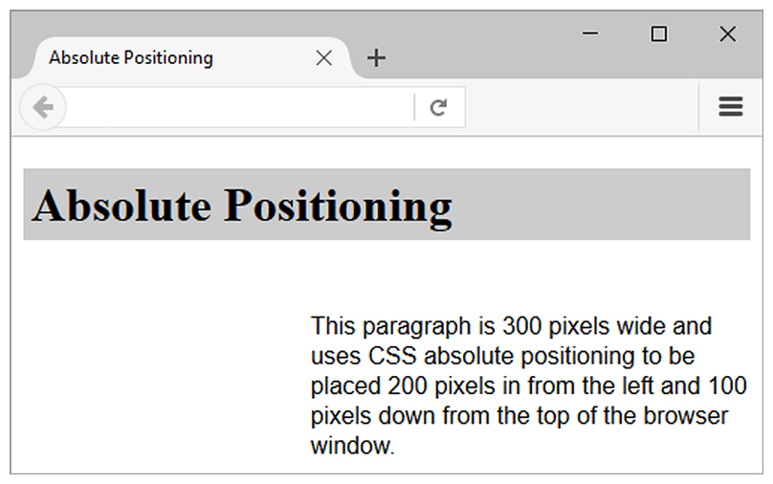
Absolute Positioning
p { position: absolute;
left: 200px;
top: 100px;
font-family: Arial, sans-serif;
width: 300px; }
Precisely specifies the location of an element outside of normal flow in in relation to its first parent non-static element

Slide 22
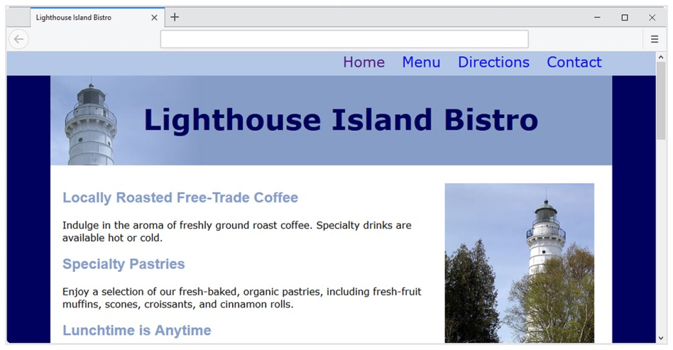
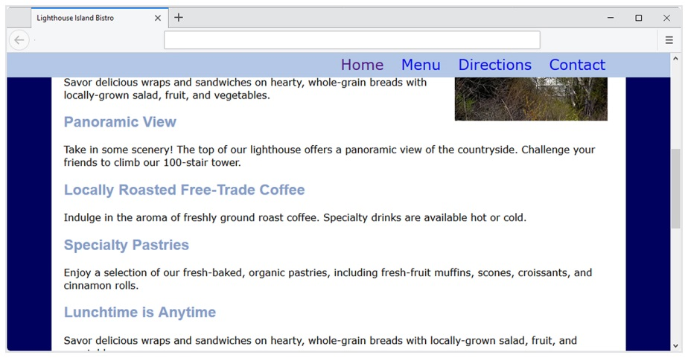
Stacking Order with the z-index Property
Configure a third dimension: the stacking order of positioned elements
Default z-index is 0
Elements with higher z-index values will stack on top of elements with lower z-index values
Example: Fixed Position Navigation Bar
nav { position: fixed; top: 0; left: 0;
height: 40px;
width: 100%; min-width: 40em;
background-color: #B 3 C 7 E 6; }

Slide 23
C S S Debugging Tips
Manually check syntax errors
Use W 3 C C S S Validator to check syntax errors
http://jigsaw.w3.org/css-validator/
Configure temporary background colors
Configure temporary borders
Use C S S comments to find the unexpected
/* the browser ignores this code */
Don’t expect your pages to look exactly the same in all browsers!
Be patient!

Slide 24
Summary
This chapter expanded your C S S skillset.
You configured web pages with floating elements with C S S.
You were introduced to fixed, relative, and absolute positioning.
You configured web pages with two-column page layouts
You used unordered lists to provide structure for navigation hyperlinks.
You added interactivity to hyperlinks with C S S pseudo-classes.
You configured a C S S sprite image.

Slide 25

Copyright
This work is protected by United States copyright laws and is provided solely for the use of instructors in teaching their courses and assessing student learning. Dissemination or sale of any part of this work (including on the World Wide Web) will destroy the integrity of the work and is not permitted. The work and materials from it should never be made available to students except by instructors using the accompanying text in their classes. All recipients of this work are expected to abide by these restrictions and to honor the intended pedagogical purposes and the needs of other instructors who rely on these materials.

